Slide 1
Serverless computing is all about the ability to focus on individual pieces of logic that are repeatable and stateless. These pieces require no infrastructure management and they consume resources only for the seconds, or milliseconds, they run for. At the core of the serverless computing movement are functions, which are made available in the Azure ecosystem by Azure Functions.

Slide 2
Azure Functions
Azure Functions is a solution for easily running small pieces of code, or "functions," in the cloud. You can write just the code you need for the problem at hand, without worrying about a whole application or the infrastructure to run it. Functions can make development even more productive, and you can use your development language of choice, such as C#, F#, Node.js, Java, or PHP. Pay only for the time your code runs and trust Azure to scale as needed. Azure Functions lets you develop serverless applications on Microsoft Azure

Slide 3
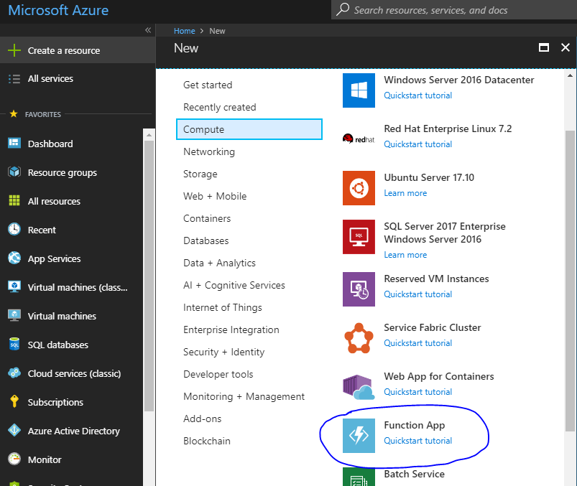

Slide 4
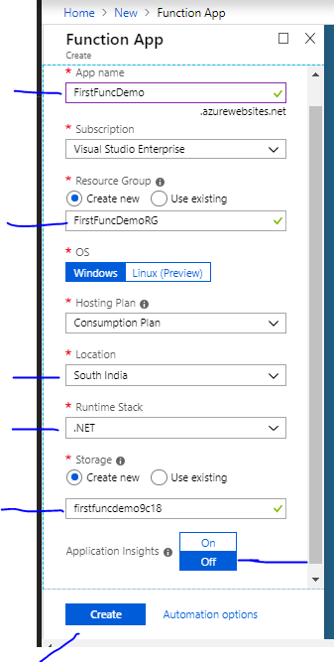

Slide 5
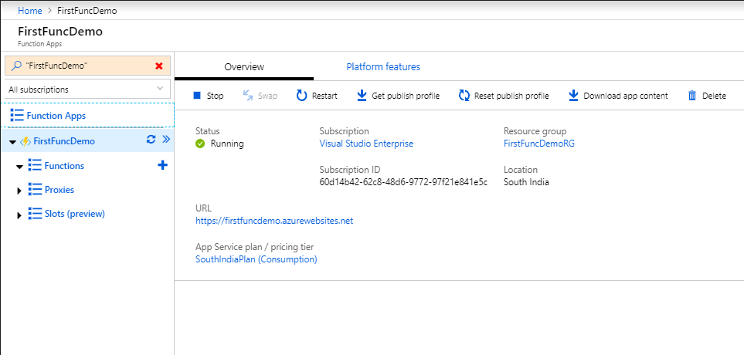

Slide 6
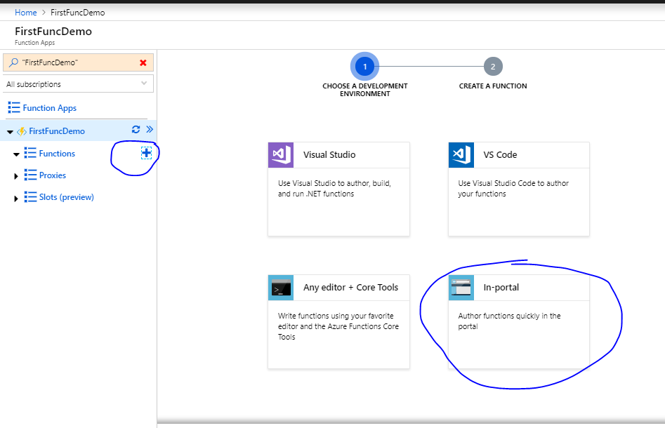

Slide 7
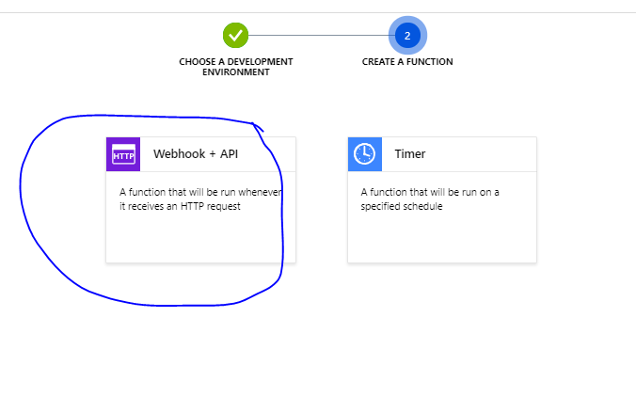

Slide 8
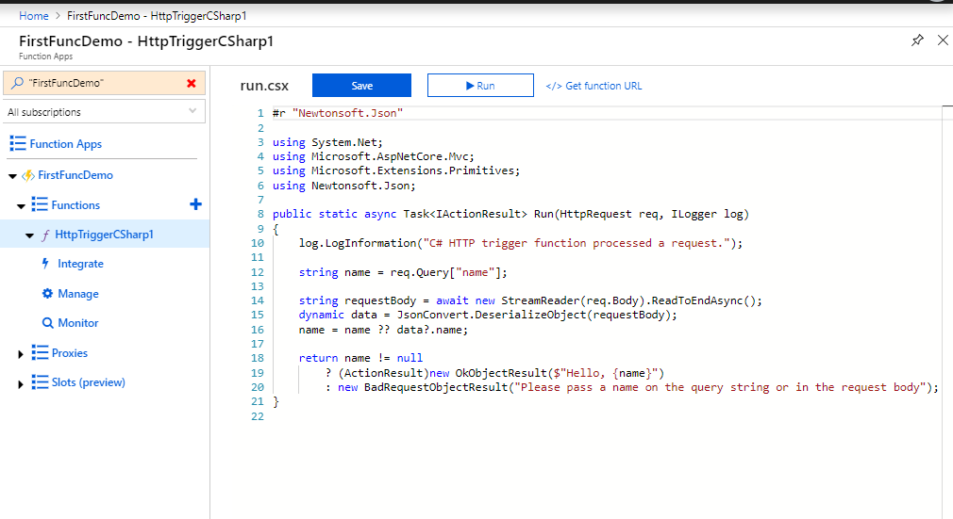
You will get like this

Slide 9
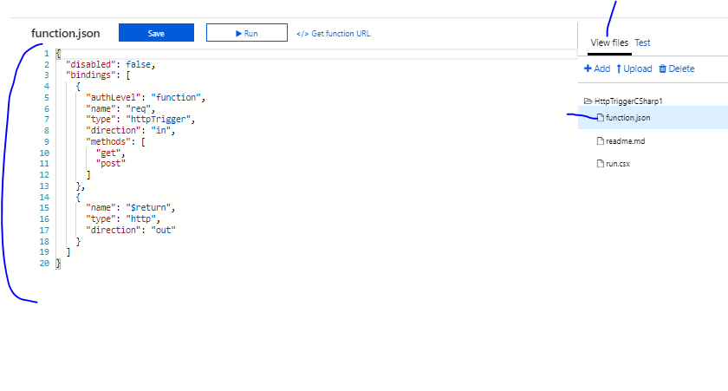

Slide 10
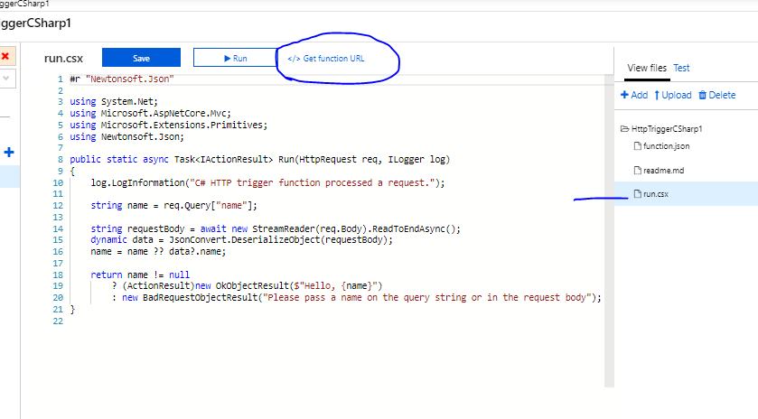

Slide 11
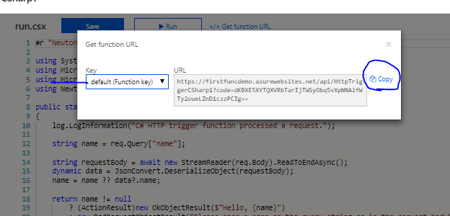

Slide 12
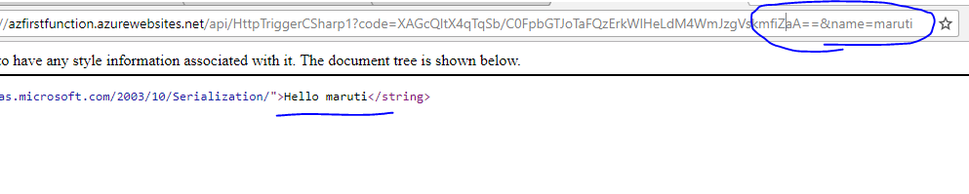

Slide 13
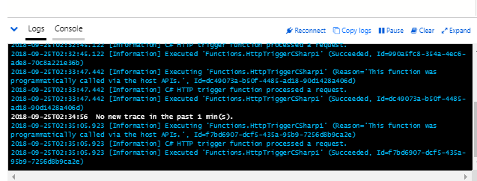
When your function runs, trace information is written to the logs. To see the trace output from the previous execution, return to your function in the portal and click the arrow at the bottom of the screen to expand the Logs.

Slide 14
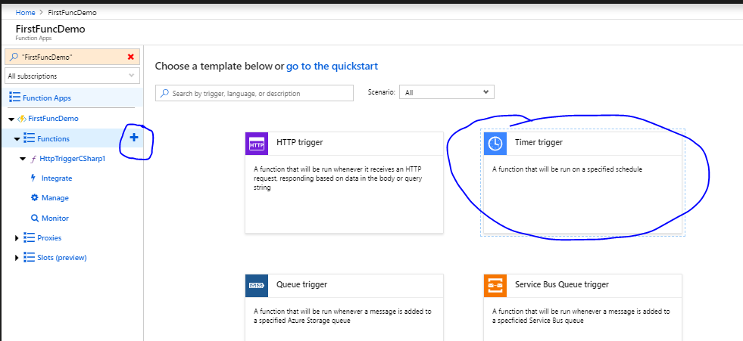

Slide 15
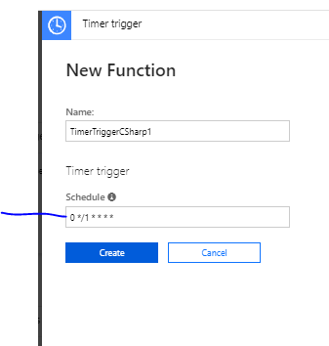
A six field CRON expression that schedules your function to run every minute.

Slide 16
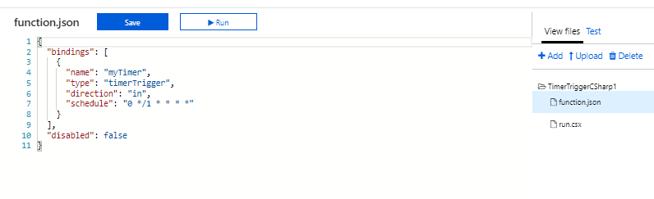

Slide 17
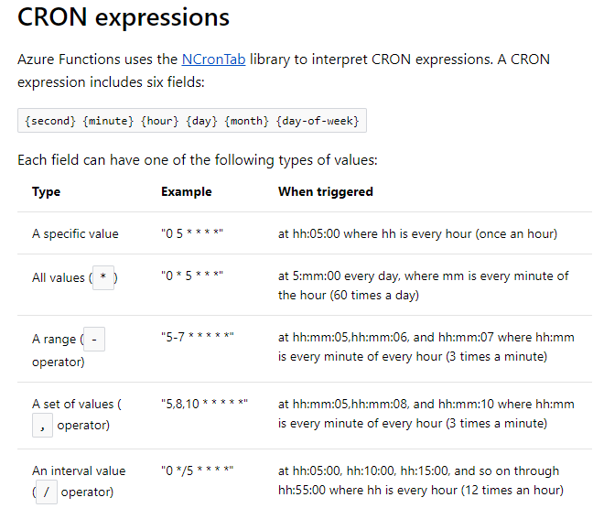

Slide 18
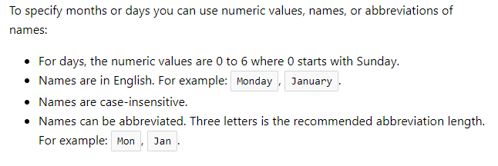
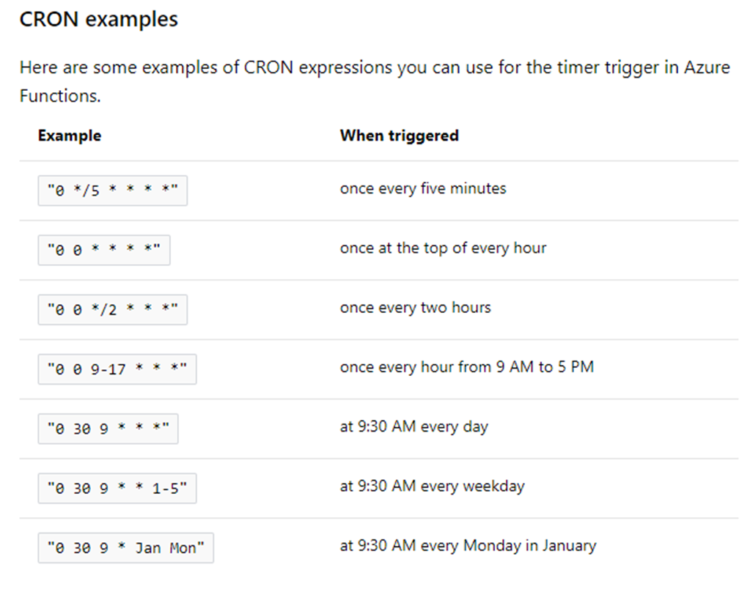

Slide 19
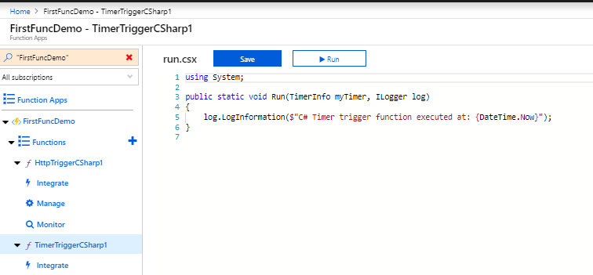
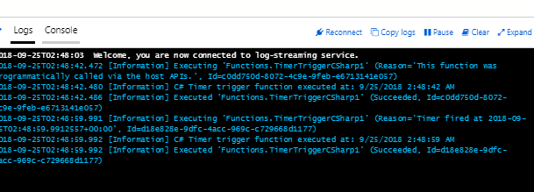
Run this function and observe logs

Slide 20
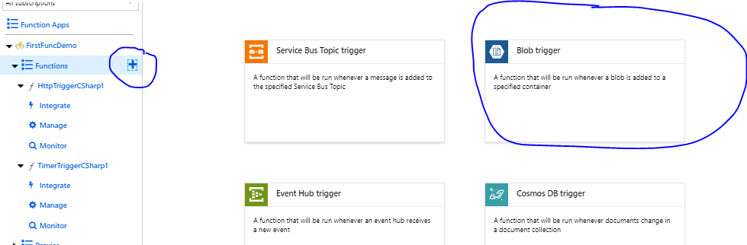

Slide 21
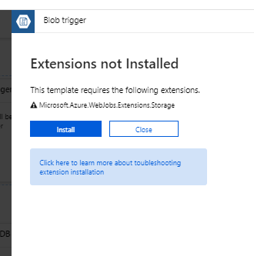
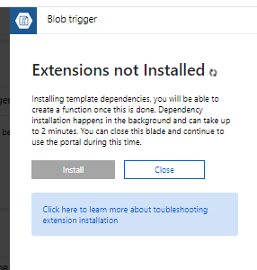

Slide 22
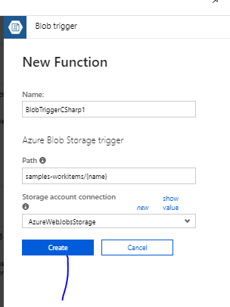

Slide 23
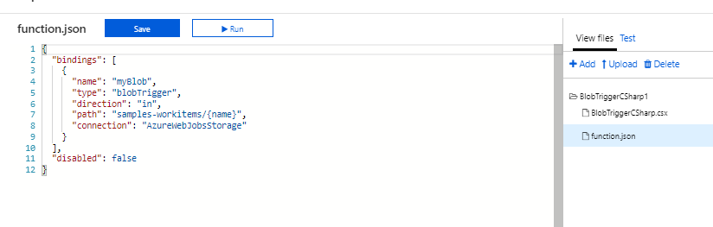
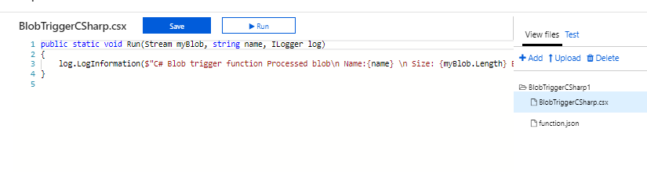

Slide 24
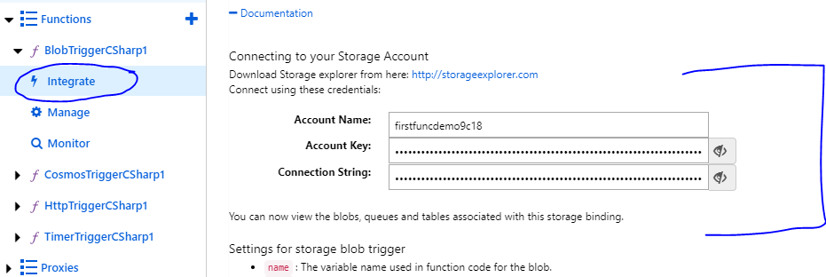
Use these properties to connect with storage

Slide 25
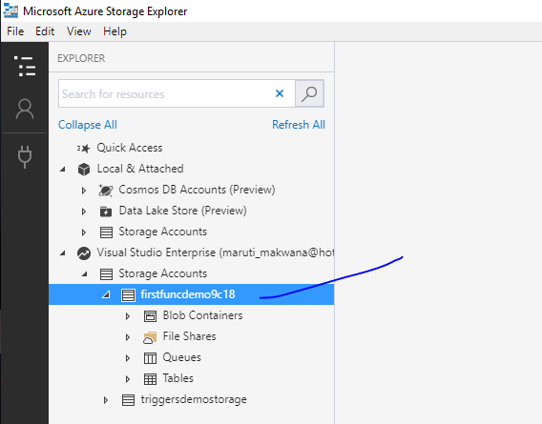

Slide 26
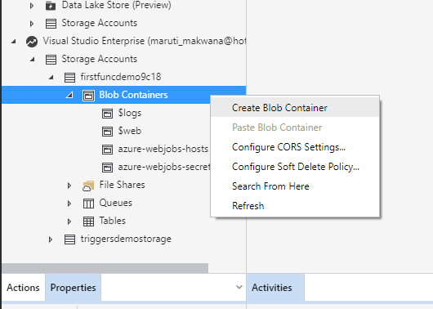

Slide 27
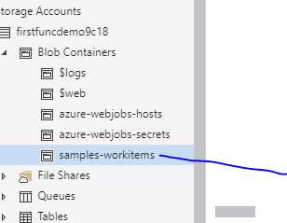

Slide 28
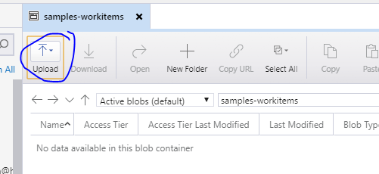
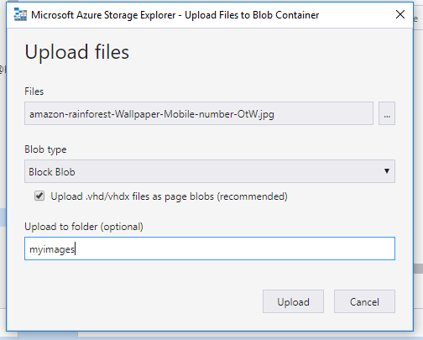

Slide 29
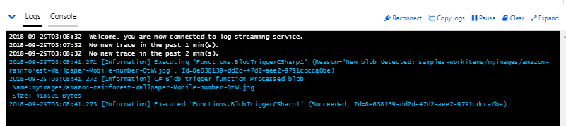
You will get log everytime you upload an item in blob

Slide 30
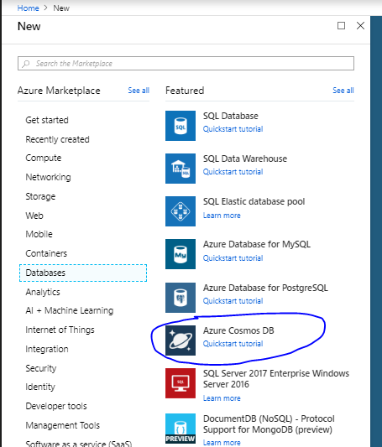

Slide 31
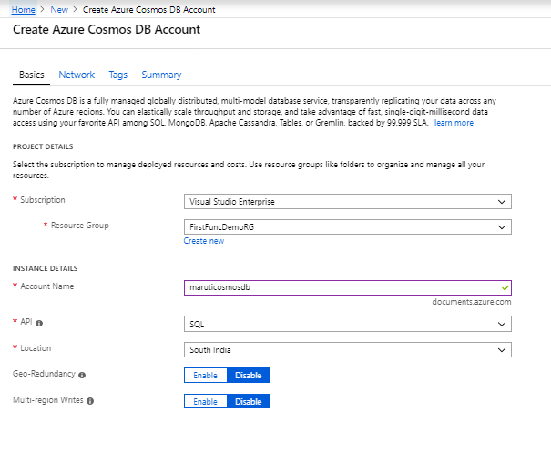

Slide 32
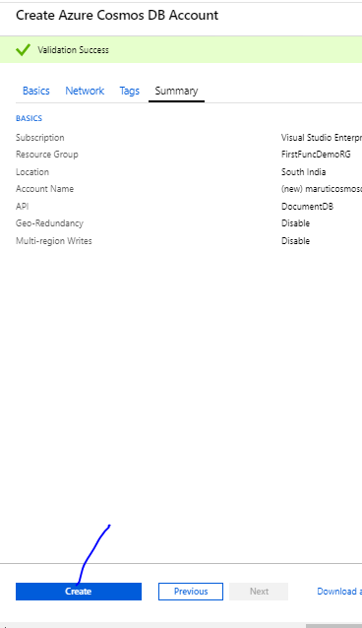
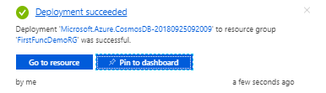

Slide 33
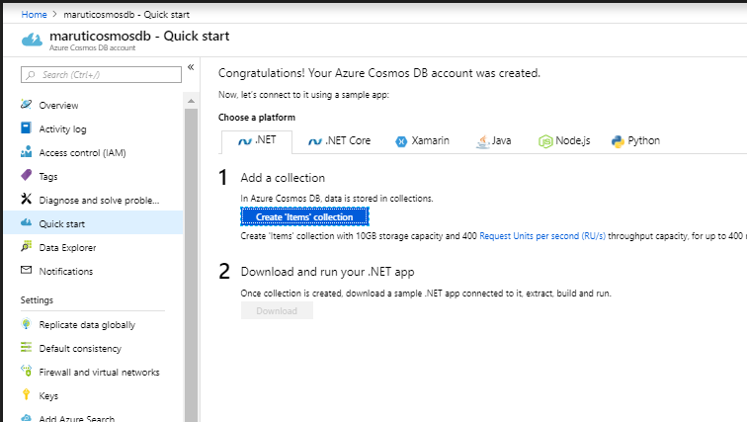
You will get like this

Slide 34
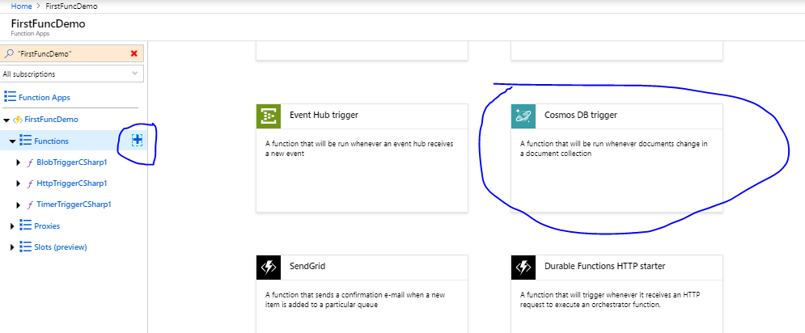

Slide 35
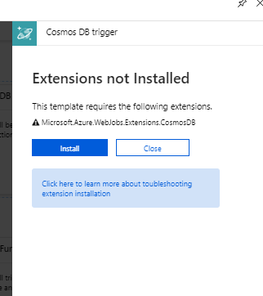
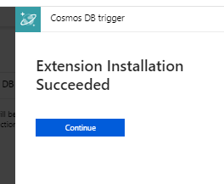

Slide 36
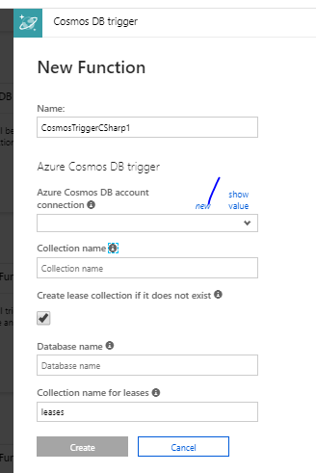
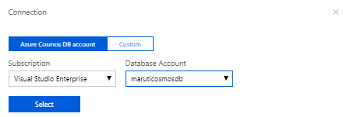

Slide 37
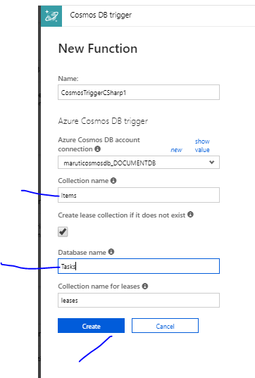

Slide 38
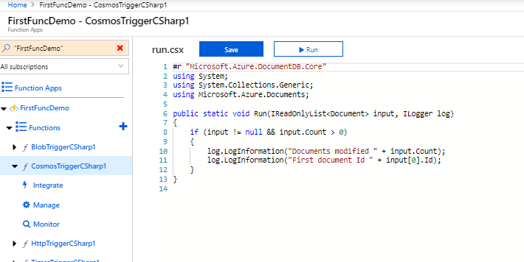
This function template writes the number of documents and the first document ID to the logs.

Slide 39
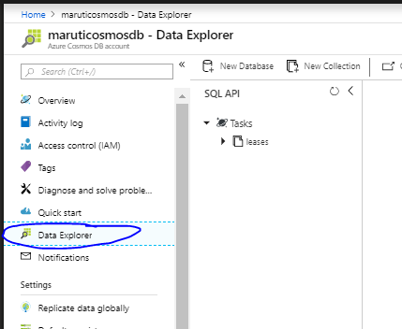
Create the Items collection

Slide 40
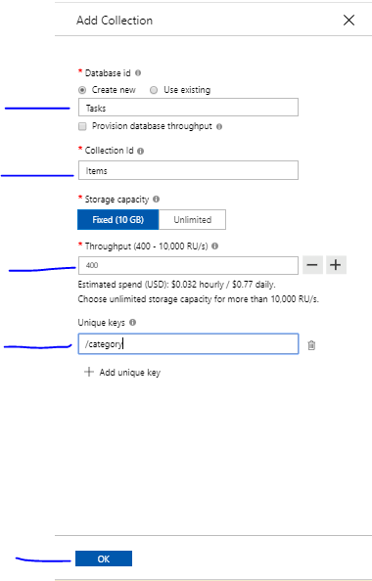

Slide 41
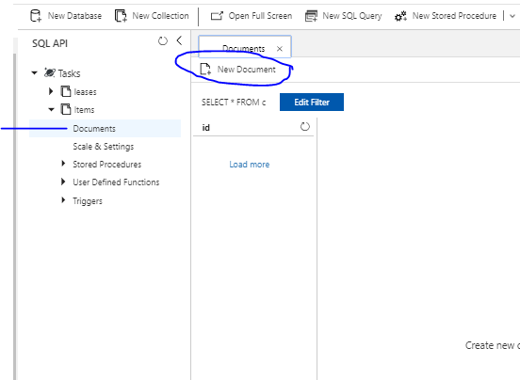

Slide 42
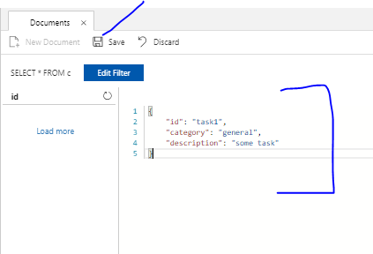
Type this and save

Slide 43
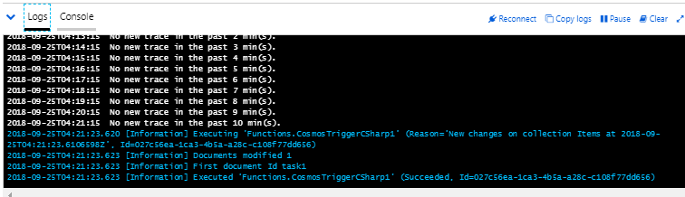
Check if function gets triggered in logs

Slide 44
Durable Functions overview
Durable Functions is an extension of Azure Functions and Azure WebJobs that lets you write stateful functions in a serverless environment. The extension manages state, checkpoints, and restarts for you.
The extension lets you define stateful workflows in a new type of function called an orchestrator function. Here are some of the advantages of orchestrator functions:
They define workflows in code. No JSON schemas or designers are needed.
They can call other functions synchronously and asynchronously. Output from called functions can be saved to local variables.

Slide 45
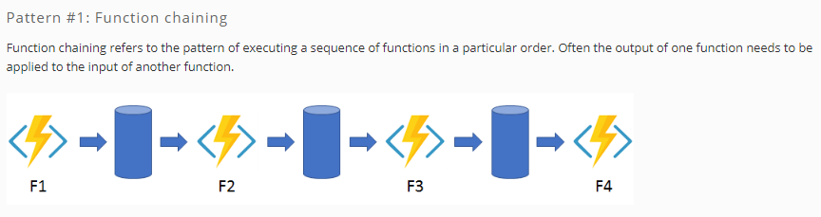
The primary use case for Durable Functions is simplifying complex, stateful coordination problems in serverless applications. The following sections describe some typical application patterns that can benefit from Durable Functions.

Slide 46


Slide 47


Slide 48


Slide 49


Slide 50


Slide 51


Slide 52


Slide 53


